Slide 1
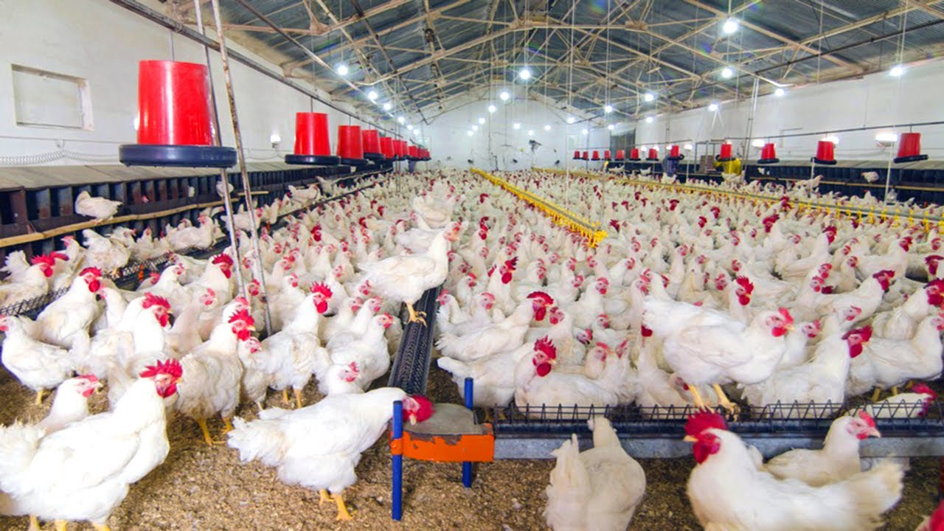
SMART POULTRY FARM
TEAM NAME : DAZZLING JEWELS
TEAM MEMBERS : A.ASHWINI REDDY
K.DEEPTHI PRIYANKA
D.AKHILA

Slide 2
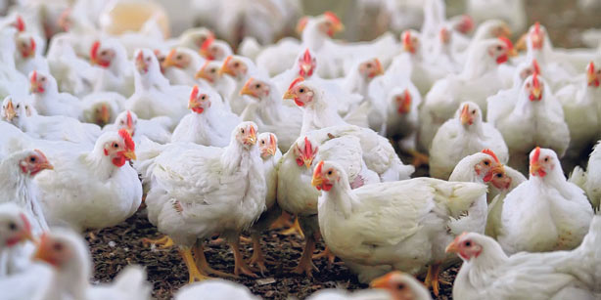

Abstract
From past years, the production of chicken in the world has been increasing gradually due to standardization farming management and good manufacturing practices.
Intelligent , network and data processing become the main features of a new round of India poultry farming infrastructure.

Slide 3
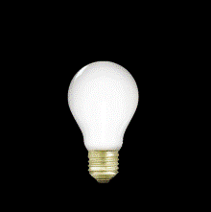

The environmental parameters like temperature, light intensity and ammonia gas are monitored and controlled automatically.
The person in-charge can able to get the knowledge regarding the interior atmosphere of poultry farm by receiving a message on his mobile number.
Based on the message received the owner can take appropriate action to control the parameters.
In addition we have also designed to control and monitor the food valve so that sufficient food is always available in the plate.

Slide 4
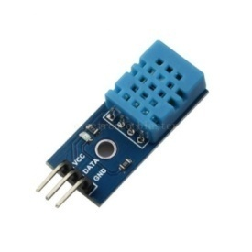
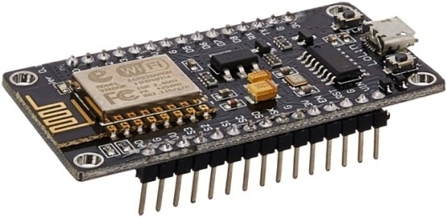
SYSTEM DESIGN
It comprises internet based system which includes remote sensors and Node MCU microcontroller.
The system can generate real time based environmental based notification to the remote server such as daily max/min temperature , humidity , air quality(moisture), lighting.
User can also control the filter fan to reduce the effect of humidity and temperature.
Systems also control the water level for chickens by using remotely monitor sensors.

Slide 5
HARDWARE COMPONENTS
SOFTWARE COMPONENTS
Node MCU
DHT 11
Smoke Sensor (MQ-7)
Servo Motor
LED
Arduino IDE
MIT App Inventor
IBM Watson
Node-RED

Slide 6
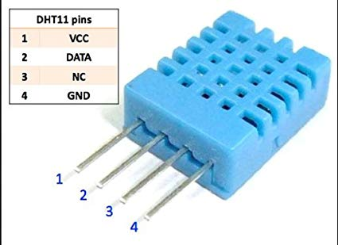
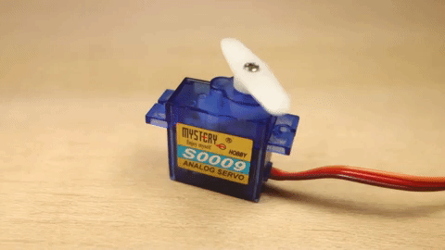
DHT11:
The DHT11 is a basic, ultra low-cost digital temperature and humidity sensor. It uses a capacitive humidity sensor and a thermistor to measure the surrounding air, and spits out a digital signal on the data pin (no analog input pins needed).
SERVOMOTOR:
A servomotor is a rotary actuator or linear actuator that allows for precise control of angular or linear position, velocity and acceleration.

Slide 7
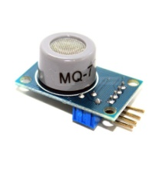
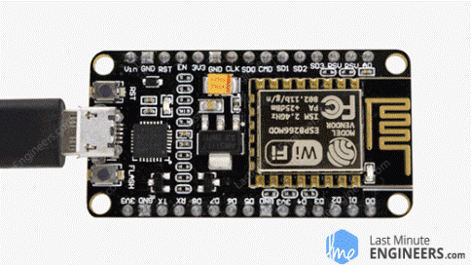
MQ-7:
MQ-7 is a Carbon Monoxide (CO) sensor, suitable for sensing Carbon Monoxide concentrations(PPM) in the air. The MQ-7 sensor can measure CO concentrations ranging from 20 to 2000ppm. This sensor has a high sensitivity and fast response time. The sensor's output is an analog resistance.
Node MCU :
Node MCU is an open source IoT platform. It includes firmware which runs on the ESP8266 Wi-Fi SoC from Espressif Systems, and hardware which is based on the ESP-12 module. The term "NodeMCU" by default refers to the firmware rather than the development kits.

Slide 8
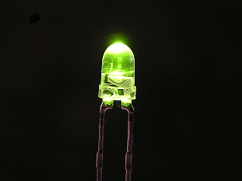
LEDS:
A light-emitting diode (LED) is a semiconductor light source that emits light when current flows through it. Electrons in the semiconductor recombine with electron holes, releasing energy in the form of photons. This effect is called electroluminescence.

Slide 9
BLOCK DIAGRAM
DHT 11
Node MCU
MQ-7
(smoke sensor)
Mobile App
Servo motor
Website
IBM Cloud
LED

Slide 10
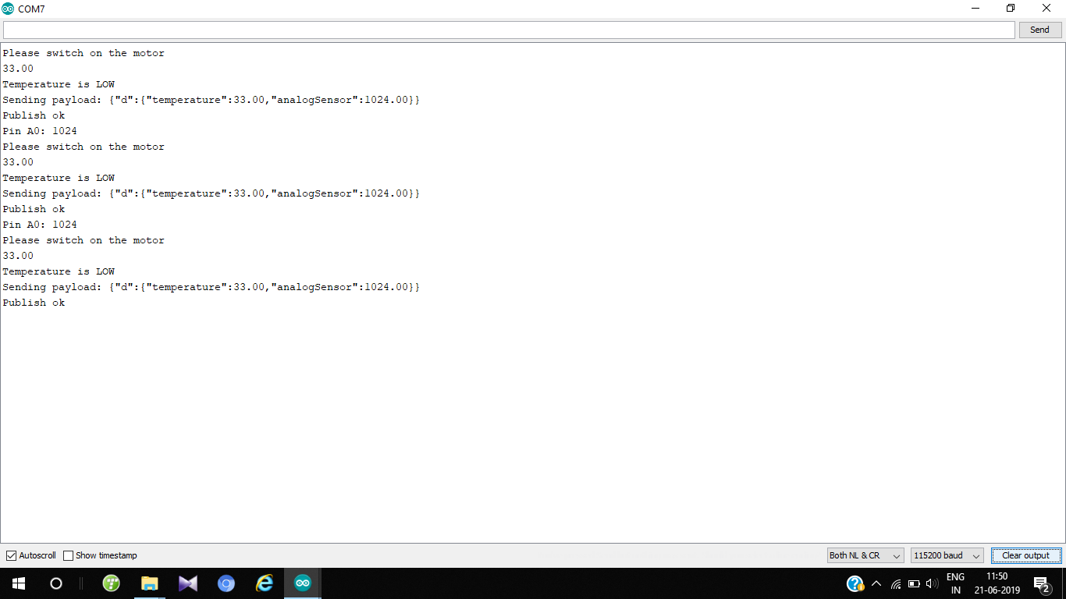
SERIAL MONITOR OUTPUT

Slide 11
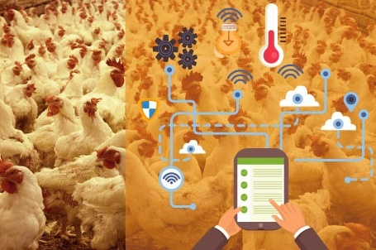
CONCLUSION
Monitoring environmental parameters in a real time industry is crucial . In this various environmental parameters for effective growth of chickens have been identified and defined . It also explains the method to automatically switch on the fans based on threshold values of temperature. As well as remote monitoring is done and with the help of this facility , the person in-charge can observe the situation and can react quickly if anything went wrong .

Slide 12
FUTURE SCOPE:
There have been various survey’s that have been carried out in places like Saudi Arabia and Japan and it was inferred that most of the chickens were usually affected by the avian influenza virus. Poultry farms usually provide plenty of animal waste and by using that, goober gas can be developed and can be used for daily energy requirements. Hence, it’s very important to maintain the proper environment for the chickens.

Slide 13


